Slide 1

Database Systems: Design, Implementation, and Management
Eighth Edition
Chapter 5
Normalization of Database Tables

Slide 2
Objectives
In this chapter, you will learn:
  What normalization is and what role it plays in the database design process
  About the normal forms 1NF, 2NF, 3NF, BCNF,
  and 4NF
  How normal forms can be transformed from lower normal forms to higher normal forms
  That normalization and ER modeling are used concurrently to produce a good database design
  That some situations require denormalization to generate information efficiently
Database Systems, 8th Edition

Slide 3
Database Tables and Normalization
Normalization
  Process for evaluating and correcting table structures to minimize data redundancies
    Reduces data anomalies
  Works through a series of stages called normal forms:
    First normal form (1NF)
    Second normal form (2NF)
    Third normal form (3NF)
Database Systems, 8th Edition

Slide 4
Database Tables and Normalization (continued)
Normalization (continued)
  2NF is better than 1NF; 3NF is better than 2NF
  For most business database design purposes, 3NF is as high as needed in normalization
  Highest level of normalization is not always most desirable
Denormalization produces a lower normal form
  Price paid for increased performance is greater data redundancy
Database Systems, 8th Edition

Slide 5
The Need for Normalization
Example: company that manages building projects
  Charges its clients by billing hours spent on each contract
  Hourly billing rate is dependent on employee’s position
  Periodically, report is generated that contains information such as displayed in Table 5.1
Database Systems, 8th Edition

Slide 6
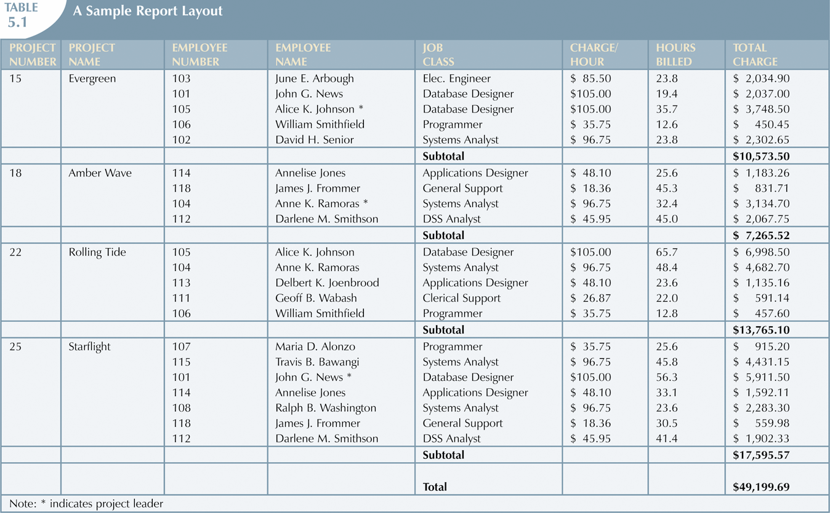
Database Systems, 8th Edition

Slide 7
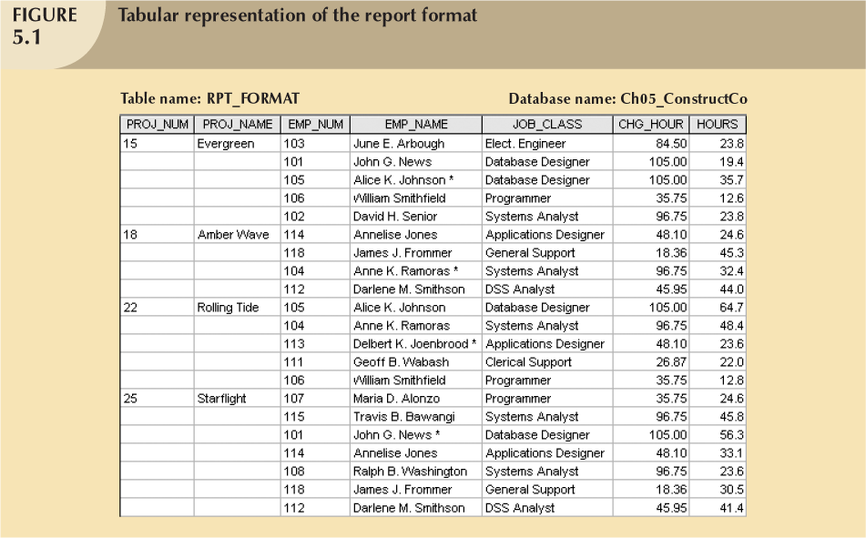
Database Systems, 8th Edition

Slide 8
The Need for Normalization (continued)
Structure of data set in Figure 5.1 does not handle data very well
Table structure appears to work; report generated with ease
Report may yield different results depending on what data anomaly has occurred
Relational database environment suited to help designer avoid data integrity problems
Database Systems, 8th Edition

Slide 9
The Normalization Process
Each table represents a single subject
No data item will be unnecessarily stored in more than one table
All attributes in a table are dependent on the primary key
Each table void of insertion, update, deletion anomalies
Database Systems, 8th Edition

Slide 10
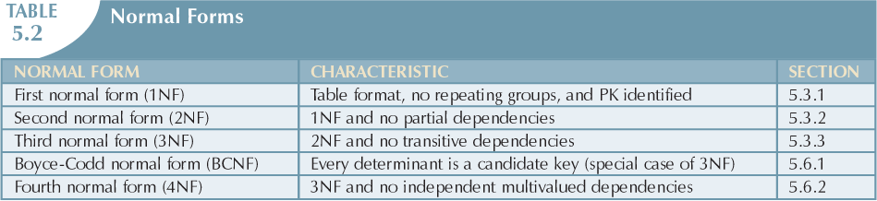
Database Systems, 8th Edition

Slide 11
The Normalization Process (continued)
Objective of normalization is to ensure all tables in at least 3NF
Higher forms not likely to be encountered in business environment
Normalization works one relation at a time
Progressively breaks table into new set of relations based on identified dependencies
Database Systems, 8th Edition

Slide 12
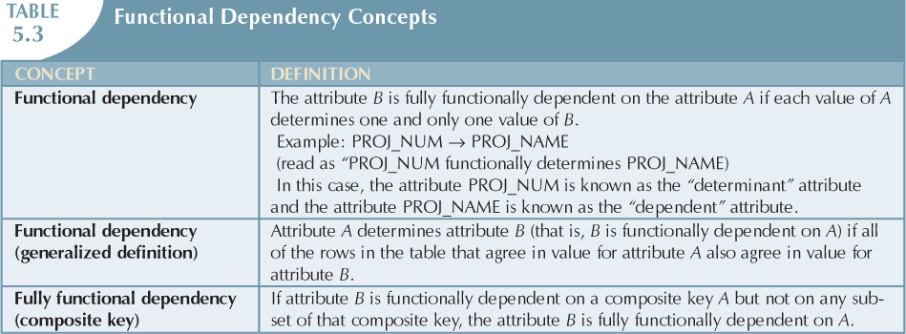
Database Systems, 8th Edition

Slide 13
Conversion to First Normal Form
Repeating group
  Group of multiple entries of same type exist for any single key attribute occurrence
Relational table must not contain repeating groups
Normalizing table structure will reduce data redundancies
Normalization is three-step procedure
Database Systems, 8th Edition

Slide 14
Conversion to First Normal Form (continued)
Step 1: Eliminate the Repeating Groups
  Eliminate nulls: each repeating group attribute contains an appropriate data value
Step 2: Identify the Primary Key
  Must uniquely identify attribute value
  New key must be composed
Step 3: Identify All Dependencies
  Dependencies depicted with a diagram
Database Systems, 8th Edition

Slide 15
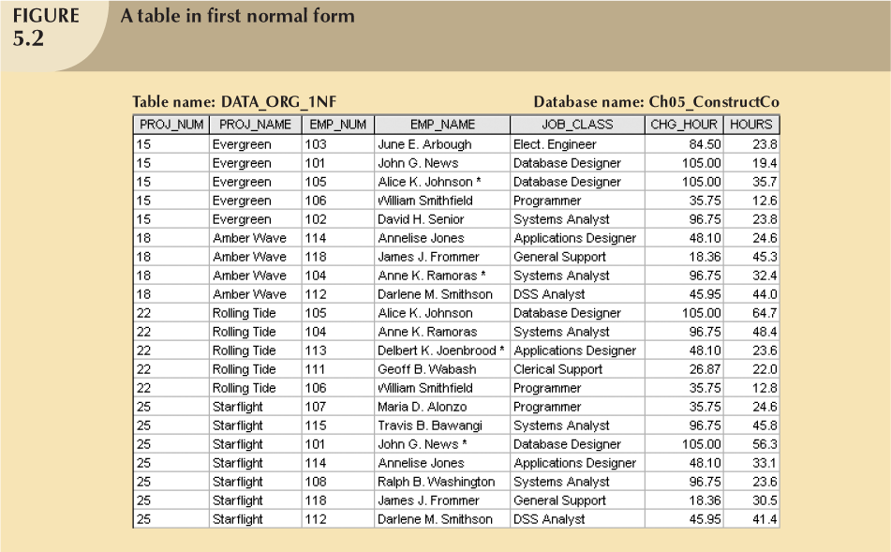
Database Systems, 8th Edition

Slide 16
Conversion to First Normal Form (continued)
Dependency diagram:
  Depicts all dependencies found within given table structure
  Helpful in getting bird’s-eye view of all relationships among table’s attributes
  Makes it less likely that you will overlook an important dependency
Database Systems, 8th Edition

Slide 17
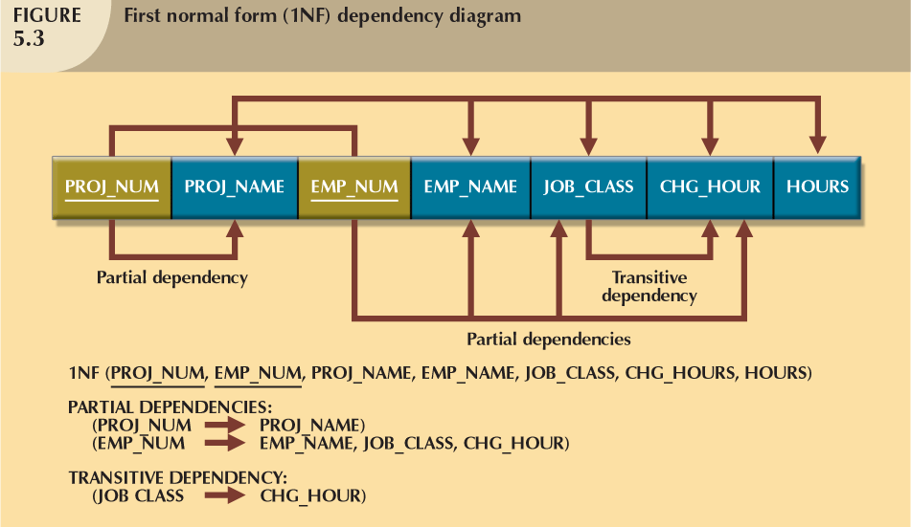
Database Systems, 8th Edition

Slide 18
Conversion to First Normal Form (continued)
First normal form describes tabular format in which:
  All key attributes are defined
  There are no repeating groups in the table
  All attributes are dependent on primary key
All relational tables satisfy 1NF requirements
Some tables contain partial dependencies
  Dependencies based on part of the primary key
  Should be used with caution
Database Systems, 8th Edition

Slide 19
Conversion to Second Normal Form
Step 1: Write Each Key Component
on a Separate Line
  Write each key component on separate line, then write original (composite) key on last line
  Each component will become key in new table
Step 2: Assign Corresponding Dependent Attributes
  Determine those attributes that are dependent on other attributes
  At this point, most anomalies have been eliminated
Database Systems, 8th Edition

Slide 20
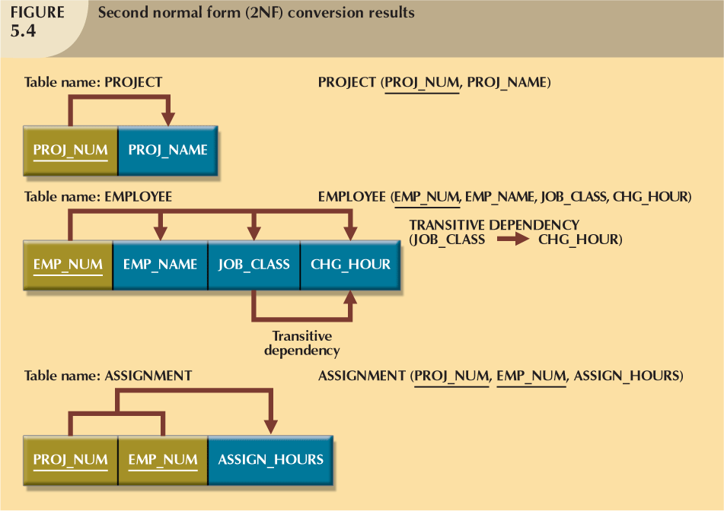
Database Systems, 8th Edition

Slide 21
Conversion to Second Normal Form (continued)
Table is in second normal form (2NF) when:
  It is in 1NF and
  It includes no partial dependencies:
    No attribute is dependent on only portion of primary key
Database Systems, 8th Edition

Slide 22
Conversion to Third Normal Form
Step 1: Identify Each New Determinant
  For every transitive dependency, write its determinant as PK for new table
  Determinant: any attribute whose value determines other values within a row
Step 2: Identify the Dependent Attributes
  Identify attributes dependent on each determinant identified in Step 1
    Identify dependency
  Name table to reflect its contents and function
Database Systems, 8th Edition

Slide 23
Conversion to Third Normal Form (continued)
Step 3: Remove the Dependent Attributes from Transitive Dependencies
  Eliminate all dependent attributes in transitive relationship(s) from each of the tables
  Draw new dependency diagram to show all tables defined in Steps 1–3
  Check new tables as well as tables modified in Step 3
    Each table has determinant
    No table contains inappropriate dependencies
Database Systems, 8th Edition

Slide 24
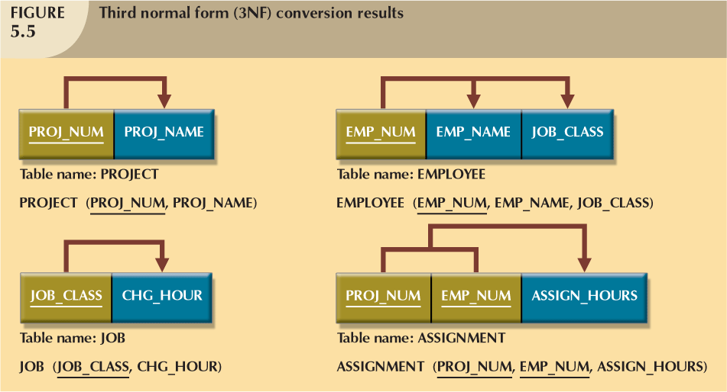
Database Systems, 8th Edition

Slide 25
Conversion to Third Normal Form (continued)
A table is in third normal form (3NF) when both of the following are true:
  It is in 2NF
  It contains no transitive dependencies
Database Systems, 8th Edition

Slide 26
Improving the Design
Table structures cleaned up to eliminate initial partial and transitive dependencies
Normalization cannot, by itself, be relied on to make good designs
It is valuable because its use helps eliminate data redundancies
Database Systems, 8th Edition

Slide 27
Improving the Design (continued)
Issues to address in order to produce a good normalized set of tables:
  Evaluate PK Assignments
  Job_Code as PK, surrogate key.
  Job_Class could violate RI const. so it is candidate key now.
  Transitive dependency created is cost
  Evaluate Naming Conventions
  CHG_HOUR to JOB_CHG_HOUR, Job_Class, Job_Description
  Refine Attribute Atomicity
  EMP_NAME is divided into first, middle_init, L_name
  Identify New Attributes
  Emp_Hiredate for tracking service period.
Database Systems, 8th Edition

Slide 28
  Identify New Relationships
  Every project is being managed by an employee
  Add FK EMP_NUM in Project table.
  Refine Primary Keys as Required for Data Granularity
  If need to maintain record of hours worked by emp
  An emp may have done some work on same day
  If date is also become part of composite PK
  Its good to have Surrogate PK Assign_Num
  Maintain Historical Accuracy
  Must keep track of transitions
  Assign_CHG_HOUR are the rates when proj was tendered
  JOB_CHG_HOUR are current rates of the Professional
  Evaluate Using Derived Attributes
  ASSIGN_Charges derived attribute should be stored in DB
  Calculated at the time of base field data entry and then stored
  Increase performance
Database Systems, 8th Edition

Slide 29
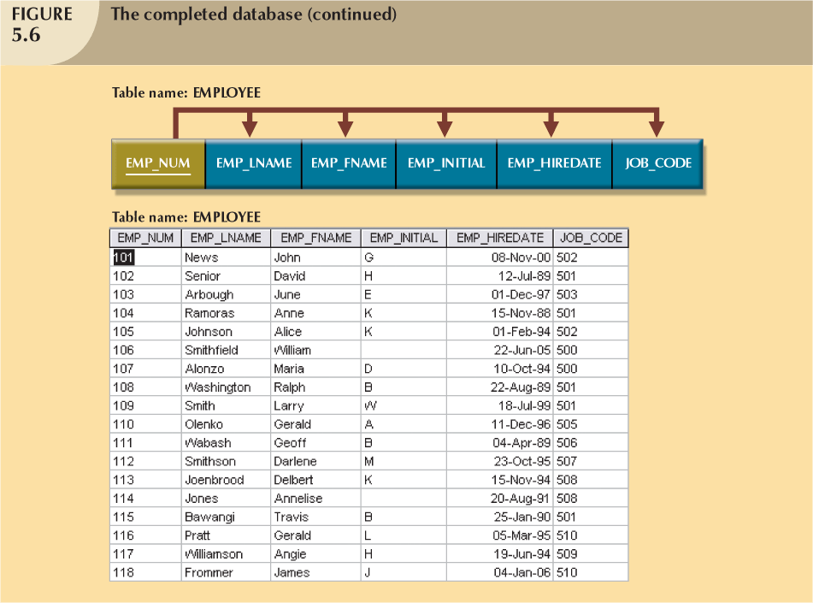
Database Systems, 8th Edition

Slide 30
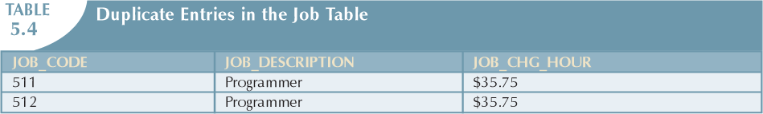
Surrogate Key Considerations
Usually numeric
Automatically generated by DBMS
Free from semantics/meanings
Hidden from end-user
When primary key is considered to be unsuitable, designers use surrogate keys
Data entries in Table 5.3 are inappropriate because they duplicate existing records
  No violation of entity or referential integrity
Database Systems, 8th Edition

Slide 31
Higher-Level Normal Forms
Tables in 3NF perform suitably in business transactional databases
Higher order normal forms useful on occasion
Two special cases of 3NF:
  Boyce-Codd normal form (BCNF)
  Fourth normal form (4NF)
Database Systems, 8th Edition

Slide 32
The Boyce-Codd Normal Form (BCNF)
Every determinant in table is a candidate key
  Has same characteristics as primary key, but for some reason, not chosen to be primary key
When table contains only one candidate key, the 3NF and the BCNF are equivalent
BCNF can be violated only when table contains more than one candidate key
Database Systems, 8th Edition

Slide 33
The Boyce-Codd Normal Form (BCNF) (continued)
Most designers consider the BCNF as special case of 3NF
Table is in 3NF when it is in 2NF and there are no transitive dependencies
Table can be in 3NF and fail to meet BCNF
  No partial dependencies, nor does it contain transitive dependencies
  A nonkey attribute is the determinant of a key attribute
Database Systems, 8th Edition

Slide 34
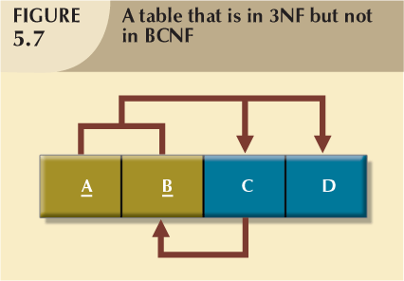
Database Systems, 8th Edition

Slide 35
Each CLASS_CODE identifies a class uniquely. This condition illustrates the case in which a course might generate many classes. For example, a course labeled INFS 420 might be taught in two classes (sections), each identified by a unique code to facilitate registration. Thus, the CLASS_CODE 32456 might identify INFS 420, class section 1, while the CLASS_CODE 32457 might identify INFS 420, class section 2. Or the CLASS_CODE 28458 might identify QM 362, class section 5.
A student can take many classes. Note, for example, that student 125 has taken both 21334 and 32456, earning the grades A and C, respectively.
A staff member can teach many classes, but each class is taught by only one staff member. Note that staff member 20 teaches the classes identified as 32456 and 28458.
Database Systems, 8th Edition

Slide 36
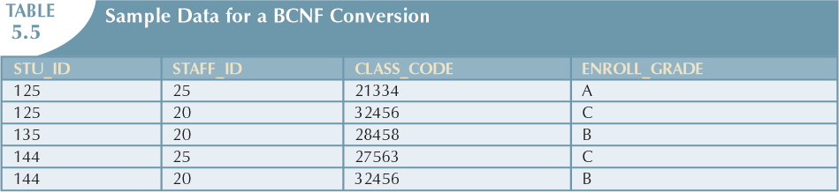
Database Systems, 8th Edition

Slide 37
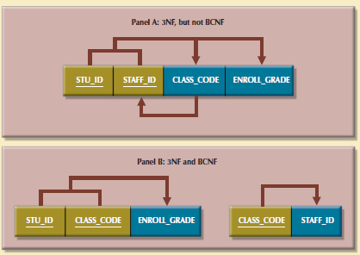
Database Systems, 8th Edition

Slide 38
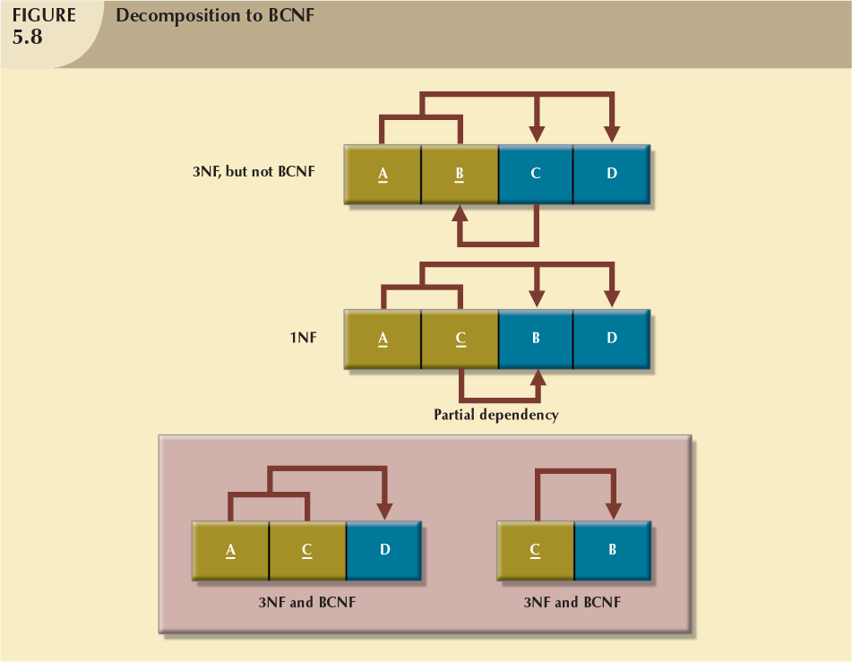
Database Systems, 8th Edition

Slide 39
Fourth Normal Form (4NF)
Table is in fourth normal form (4NF) when both of the following are true:
  It is in 3NF
  No multiple sets of multivalued dependencies
4NF is largely academic if tables conform to following two rules:
  All attributes dependent on primary key, independent of each other
  No row contains two or more multivalued facts about an entity
Database Systems, 8th Edition

Slide 40
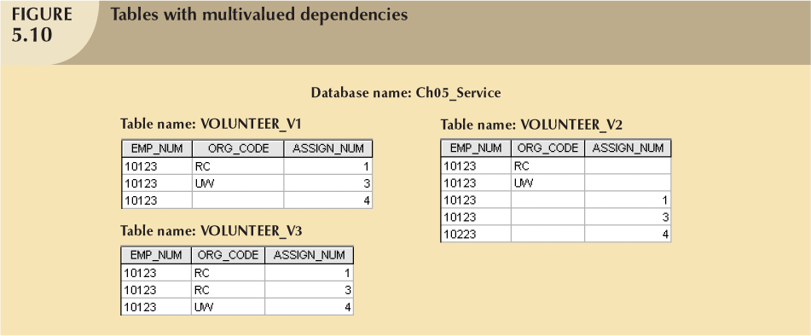
Database Systems, 8th Edition

Slide 41
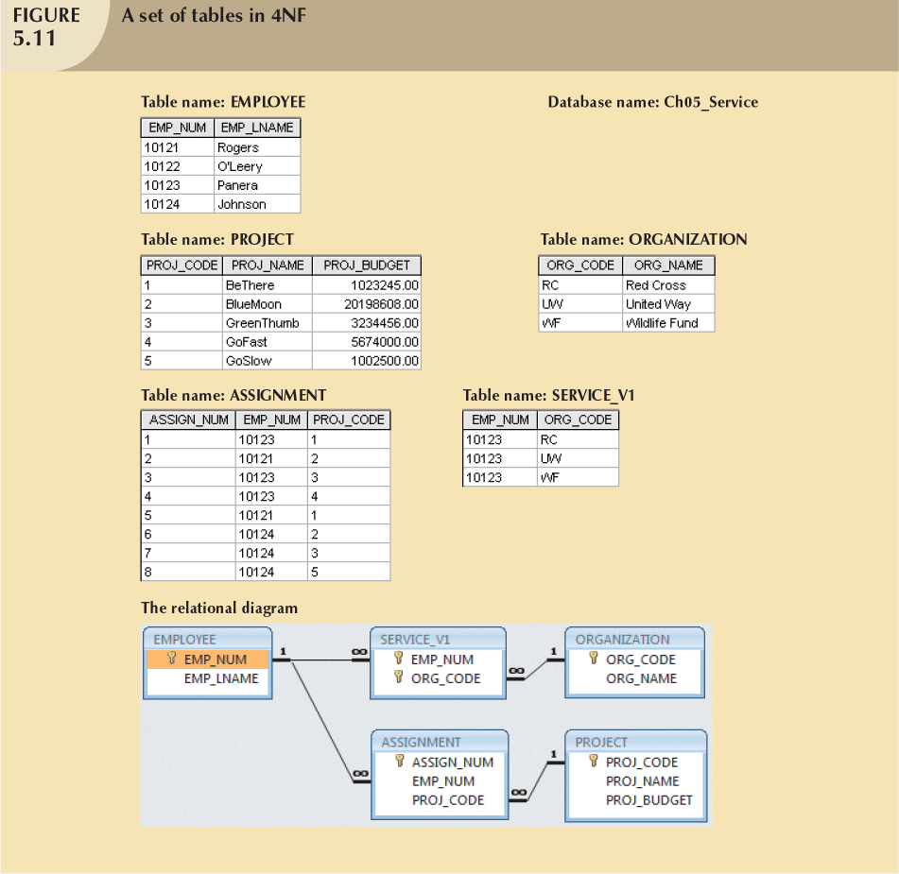

Database Systems, 8th Edition

Slide 42
Normalization and Database Design
Normalization should be part of the design process
Make sure that proposed entities meet required normal form before table structures are created
Many real-world databases have been improperly designed or burdened with anomalies
You may be asked to redesign and modify existing databases
Database Systems, 8th Edition

Slide 43
Normalization and Database Design (continued)
ER diagram
  Identify relevant entities, their attributes, and their relationships
  Identify additional entities and attributes
Normalization procedures
  Focus on characteristics of specific entities
  Micro view of entities within ER diagram
Difficult to separate normalization process from ER modeling process
Database Systems, 8th Edition

Slide 44
Contracting Co. Example
Those operations can be summarized by using the following business rules:
The company manages many projects.
Each project requires the services of many employees.
An employee may be assigned to several different projects.
Some employees are not assigned to a project and perform duties not specifically related to a project.
Some employees are part of a labor pool, to be shared by all project teams. For example, the company’s executive secretary would not be assigned to any one particular project.
Each employee has a single primary job classification. That job classification determines the hourly billing rate.
Many employees can have the same job classification. For example, the company employs more than one electrical engineer.
Database Systems, 8th Edition

Slide 45
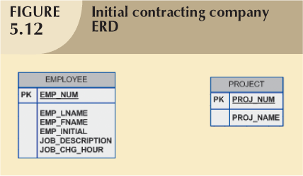
Database Systems, 8th Edition

Slide 46
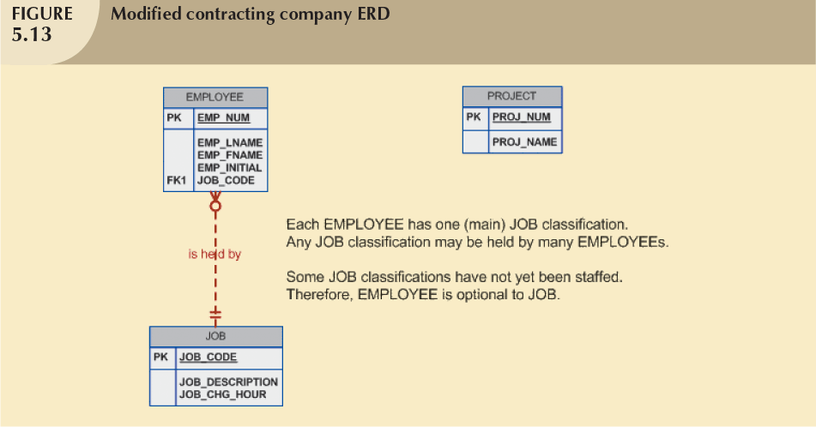
Database Systems, 8th Edition

Slide 47
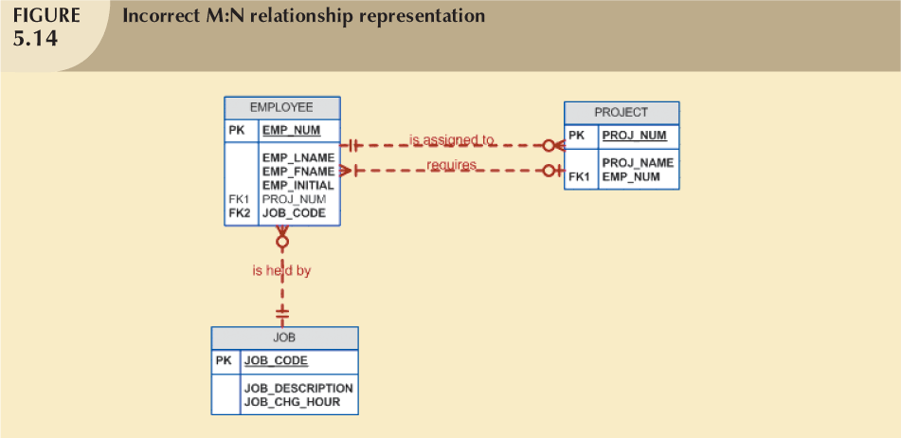
Database Systems, 8th Edition

Slide 48
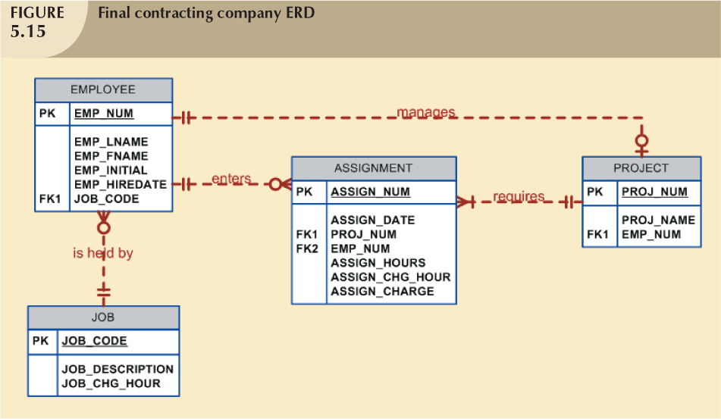
Database Systems, 8th Edition

Slide 49
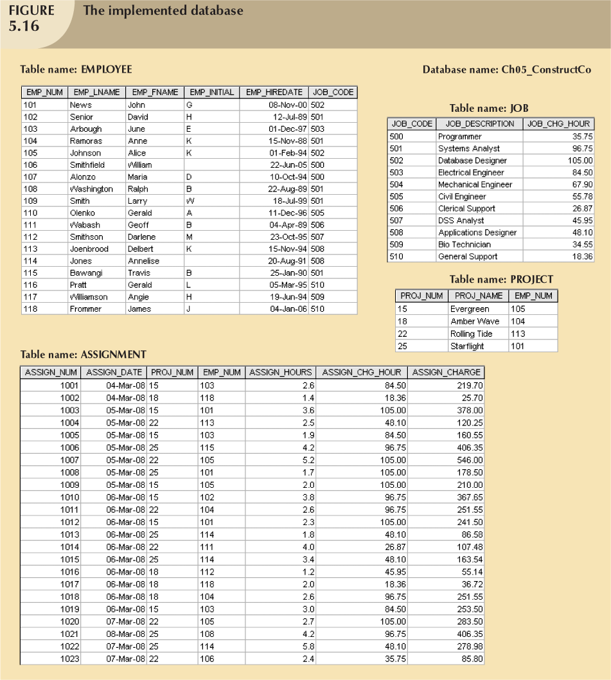
Database Systems, 8th Edition

Slide 50
Denormalization
Creation of normalized relations is important database design goal
Processing requirements should also be a goal
If tables decomposed to conform to normalization requirements:
  Number of database tables expands
Database Systems, 8th Edition

Slide 51
Denormalization (continued)
Joining the larger number of tables reduces system speed
Conflicts often resolved through compromises that may include demoralization
Defects of unnormalized tables:
  Data updates are less efficient because tables are larger
  Indexing is more cumbersome
  No simple strategies for creating virtual tables known as views
Database Systems, 8th Edition

Slide 52
Summary
Normalization is used to minimize data redundancies
First three normal forms (1NF, 2NF, and 3NF) are most commonly encountered
Table is in 1NF when:
  All key attributes are defined
  All remaining attributes are dependent on primary key
Database Systems, 8th Edition

Slide 53
Summary (continued)
Table is in 2NF when it is in 1NF and contains no partial dependencies
Table is in 3NF when it is in 2NF and contains no transitive dependencies
Table that is not in 3NF may be split into new tables until all of the tables meet 3NF requirements
Normalization is important part—but only part—of the design process
Database Systems, 8th Edition

Slide 54
Summary (continued)
Table in 3NF may contain multivalued dependencies
  Numerous null values or redundant data
Convert 3NF table to 4NF by:
  Splitting table to remove multivalued dependencies
Tables are sometimes denormalized to yield less I/O, which increases processing speed
Database Systems, 8th Edition

